Slide 1


District Counselor Meeting
January 16, 2025

Slide 2


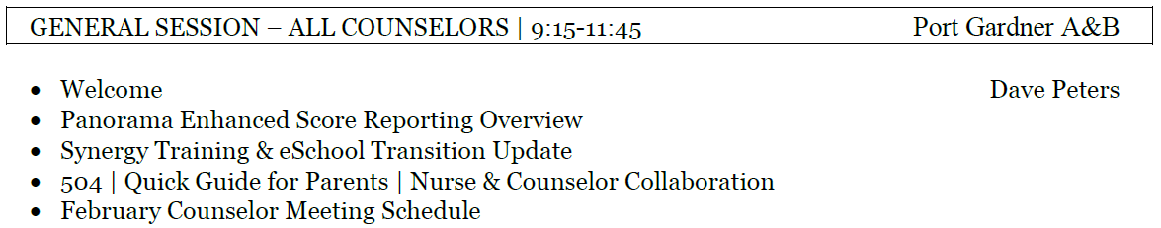
Today’s Agenda

Slide 3
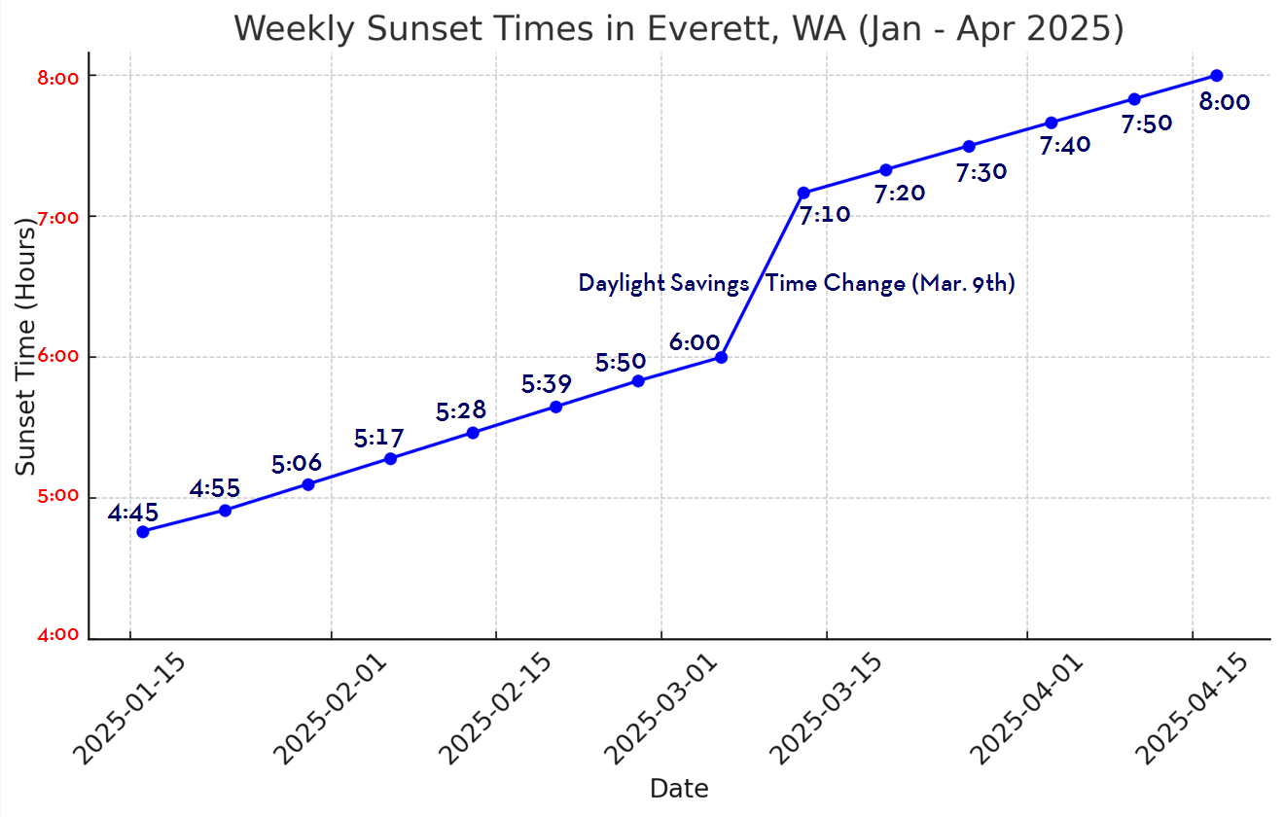
It’s Getting Lighter Later!

Slide 4

Panorama | Enhanced Score Reporting

Slide 5
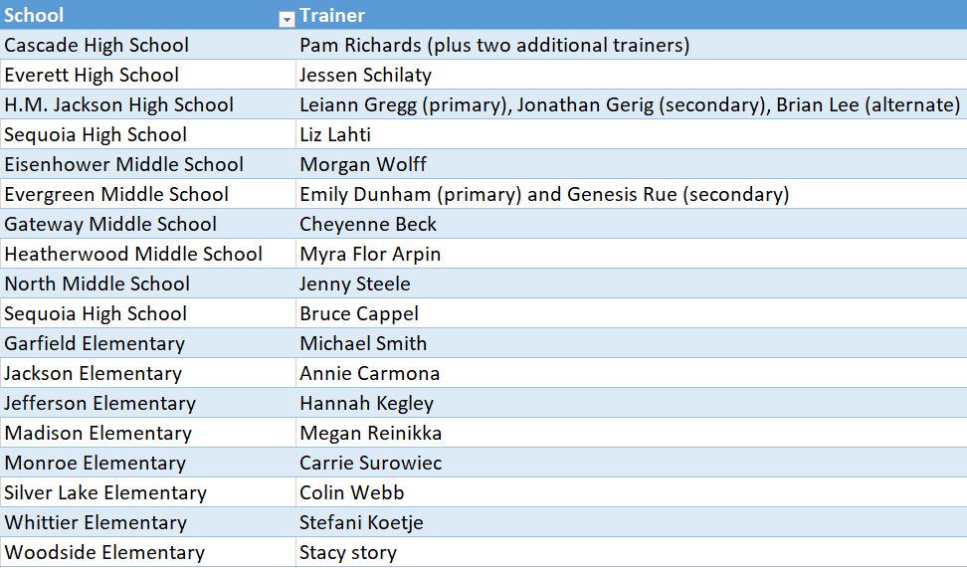

Synergy | Counselor Trainers

Slide 6
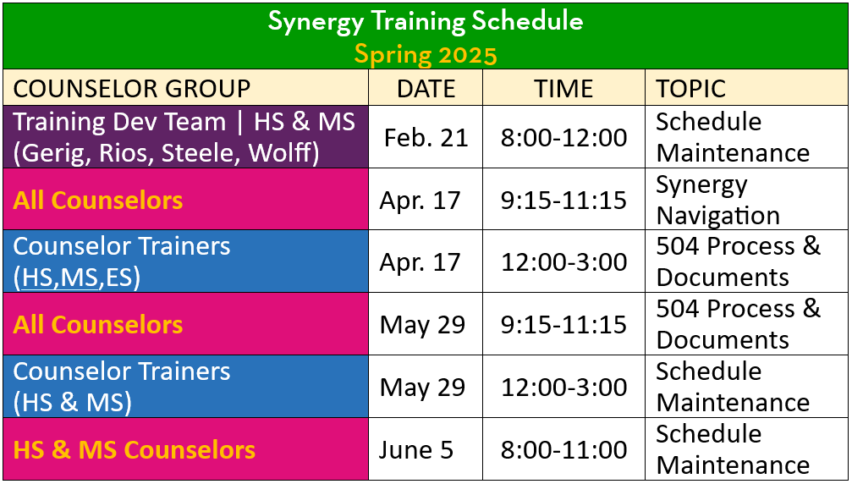
Training Schedule | Spring 2025

Slide 7
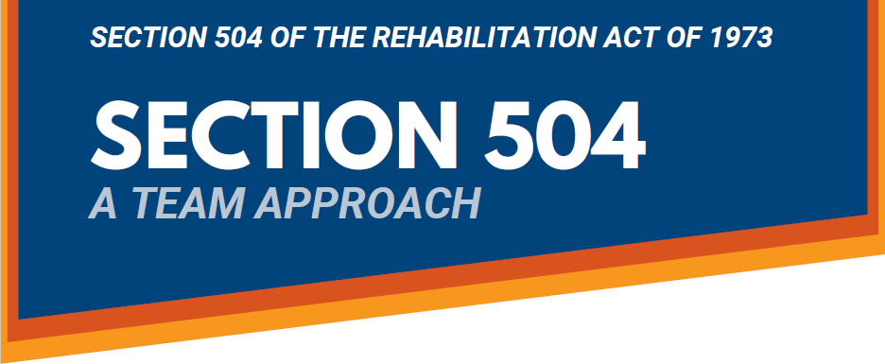
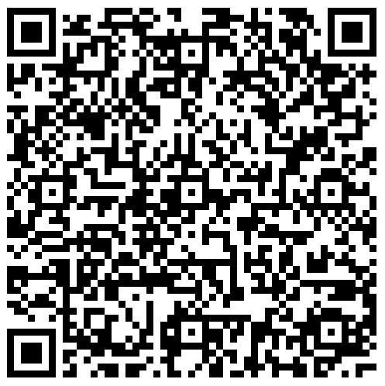
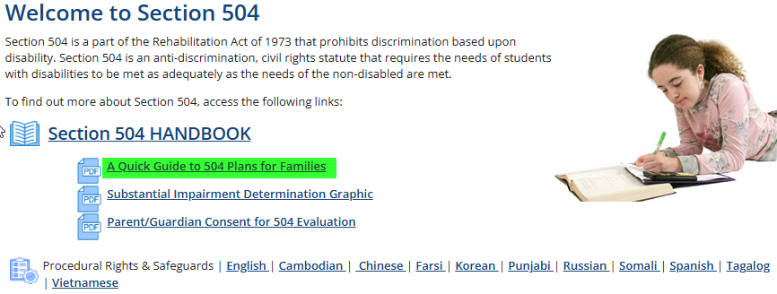

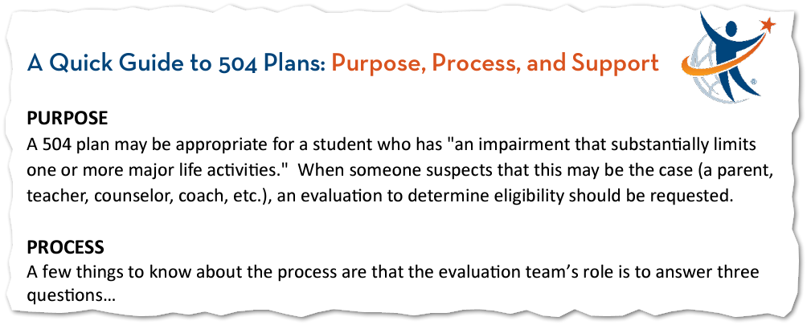
504 Quick Guide for Parents
everettsd.org/Page/5969

Slide 8
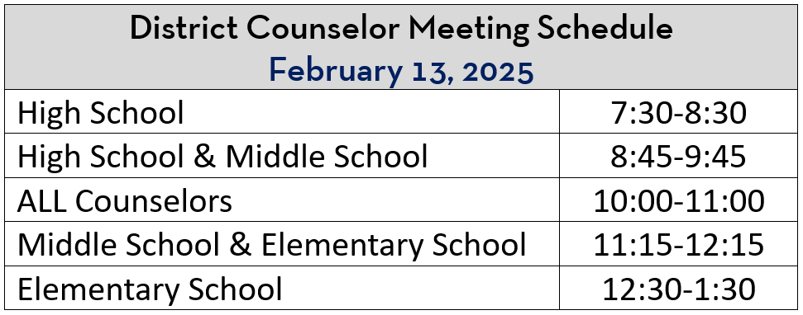

February 13th | Meeting Schedule

Slide 9


Best wishes for a smooth semester transition!

